Slide 1

Coronanxiety: NLP and Machine Learning exploration of mental health subreddits March 2020
Model

Slide 2

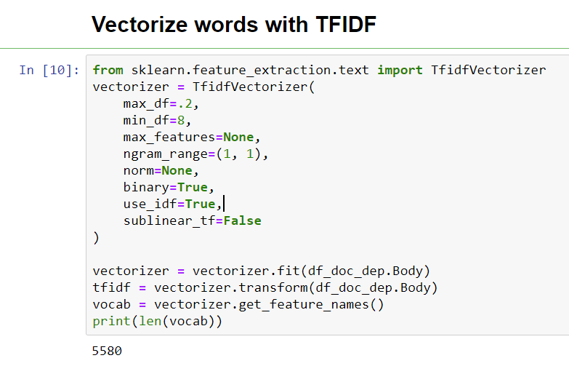
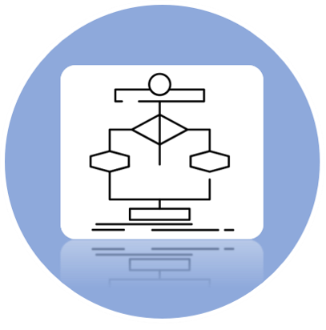







Problem Statement
Feature Extraction
NLP Viz
Data Capturing
Data Cleaning
Algorithm Selection

Slide 3
5 Horsemen of the Apocalypse
Heather Saul
Robert R Cox Jr.
Jennifer Tritle
Seung min Yoo
Aydin Jalilov

Slide 4
Problem Statement
To what degree are subredditers in the COVID19 support group rhetorically similar to Anxiety/Depression subredditers?
In March of 2020 do people in the Anxiety/Depression subreddits show concern about the virus/lockdown?
Are people in the COVID19_support group experiencing something closer to Anxiety or Depression?

Slide 5

COVID19_Support
Reddit Subreddits
with pushshift.io
Depression
Anxiety

Slide 6

Tokenize
Data Cleaning
Lemmatize
Remove
Stop-words

Slide 7


Slide 8
Feature Extraction

Slide 9
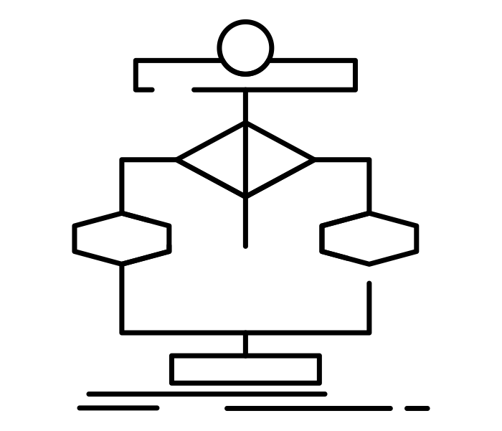
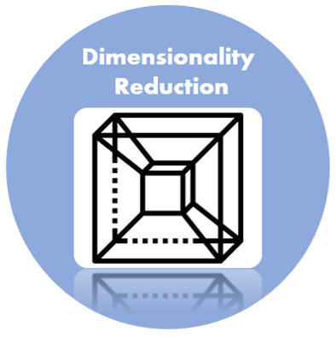
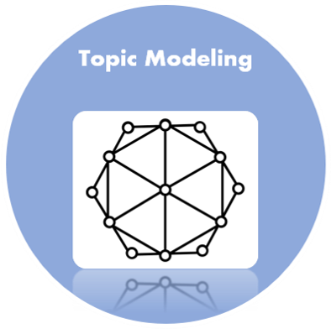

Slide 10
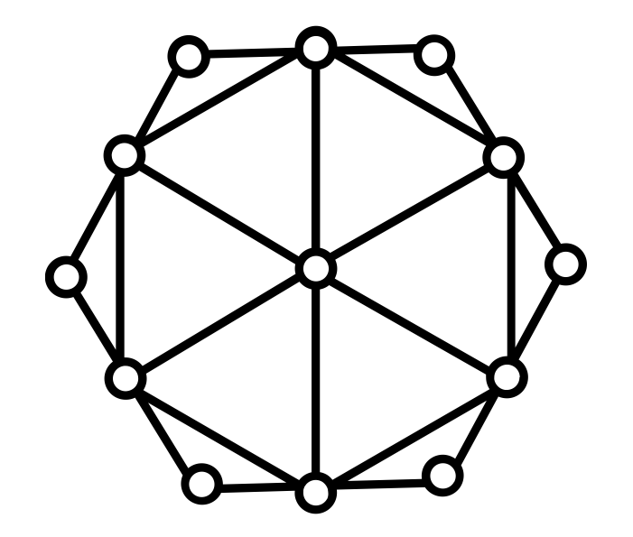
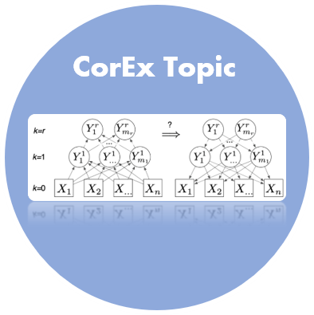
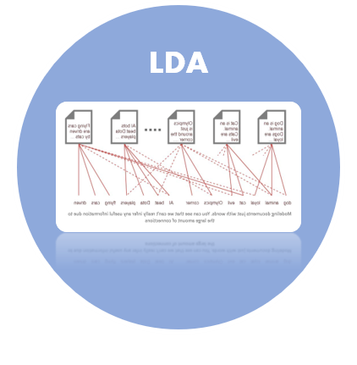
LDA imagines a fixed set of topics. Each topic represents a set of words. And the goal of LDA is to map all the documents to the topics in a way, such that the words in each document are mostly captured by those imaginary topics.
Topic Modeling
This framework learns maximally informative topics through an information-theoretic framework. It naturally generalizes to hierarchical and semi-supervised extensions with no additional modeling assumptions. Word-level domain knowledge can be flexibly incorporated within CorEx through anchor words with minimal human intervention.

Slide 11
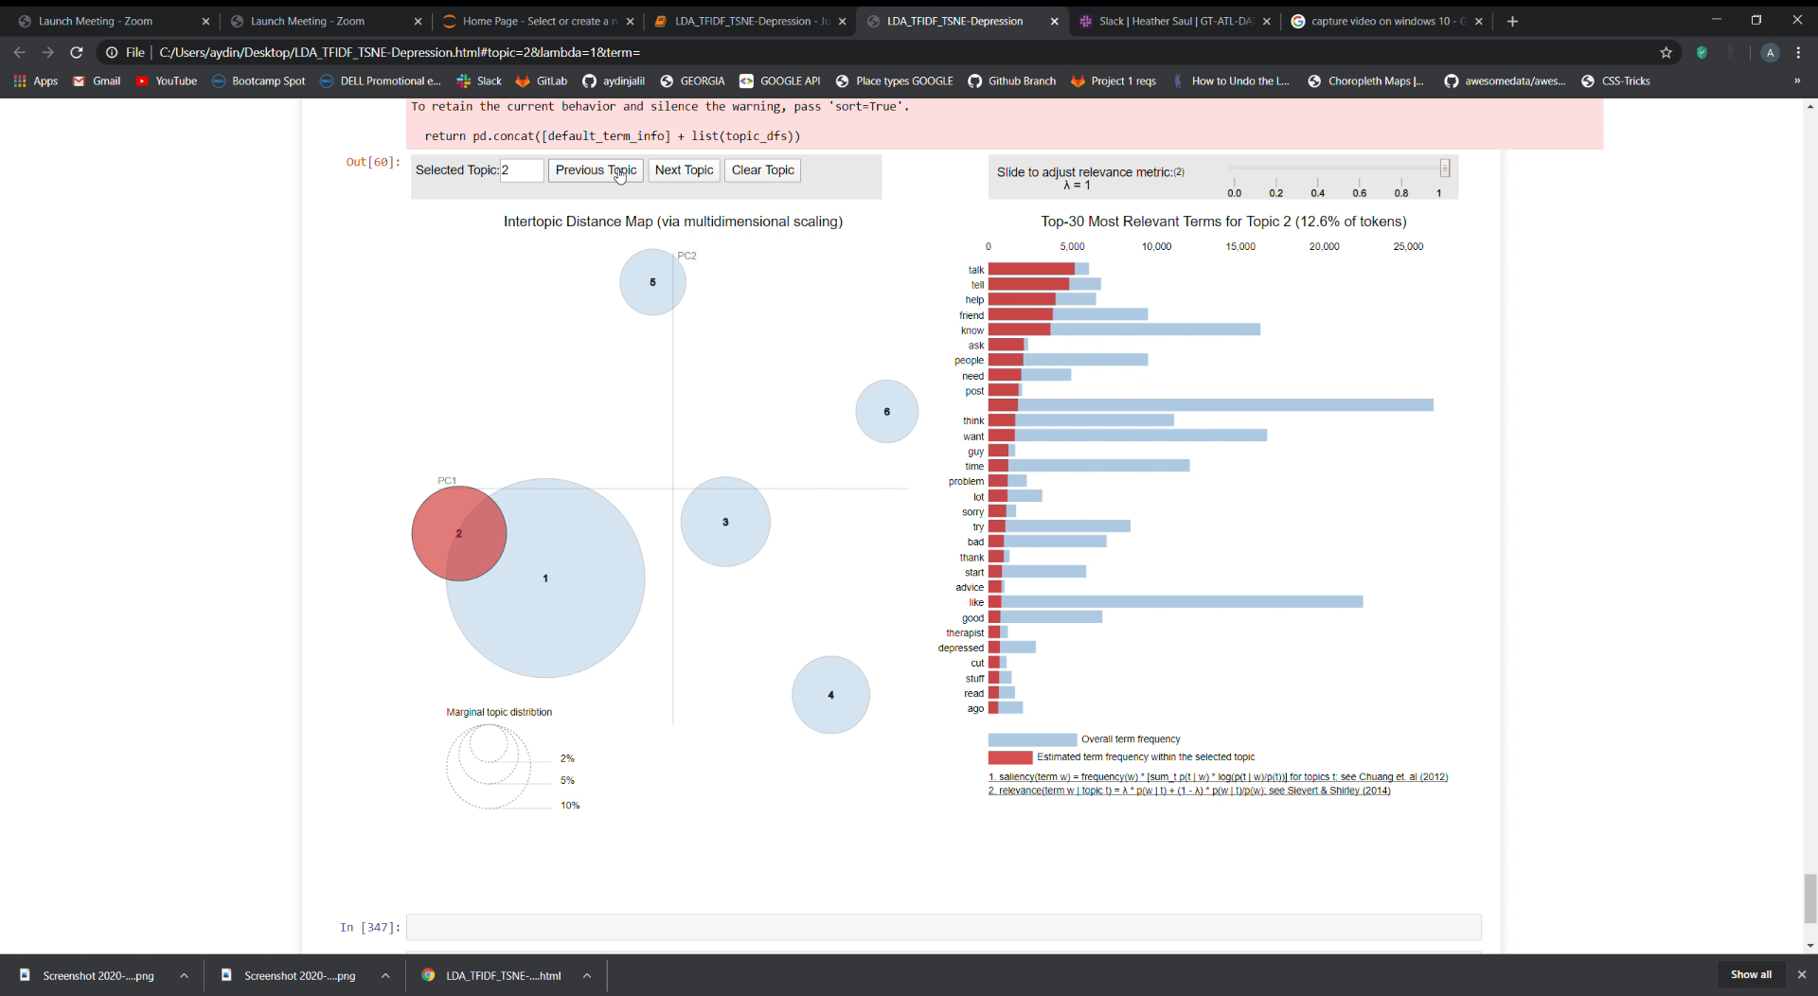
Topic Modeling-LDA

Slide 12
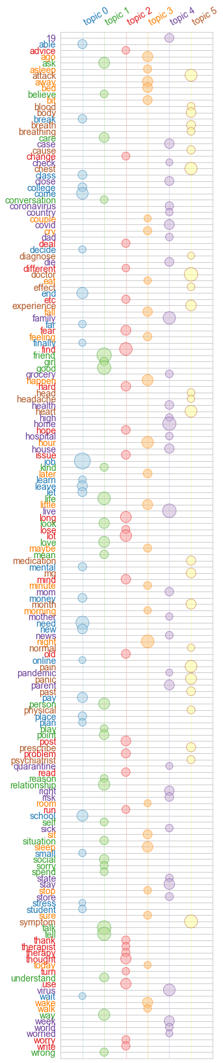
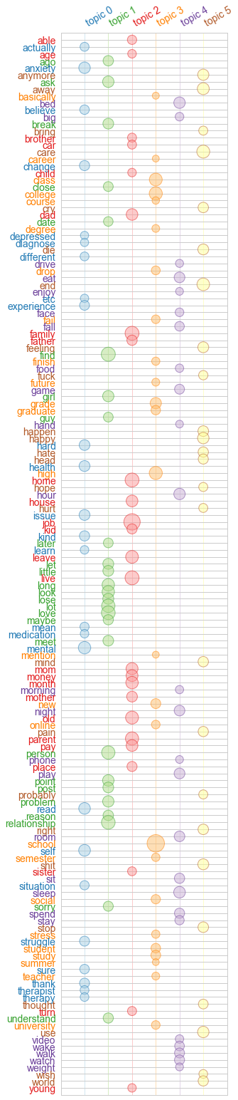
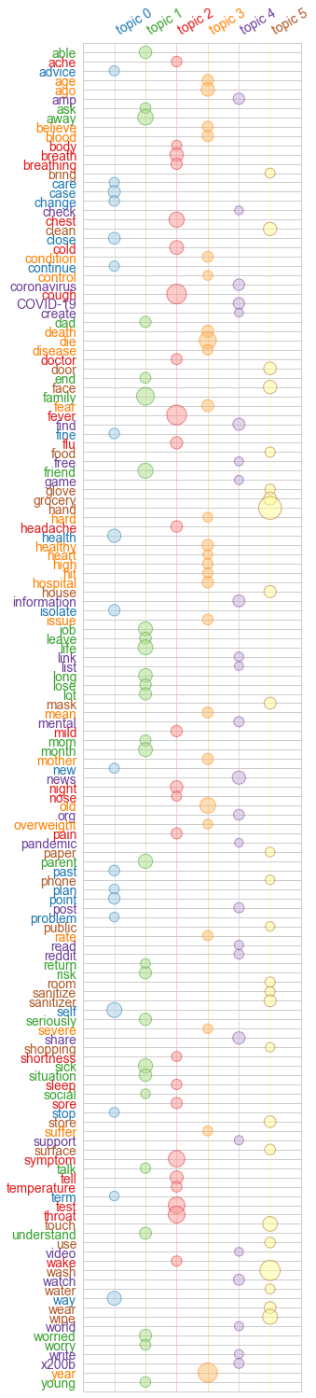
Topic Modeling-CorEx
Anxiety
Depression
COVID

Slide 13
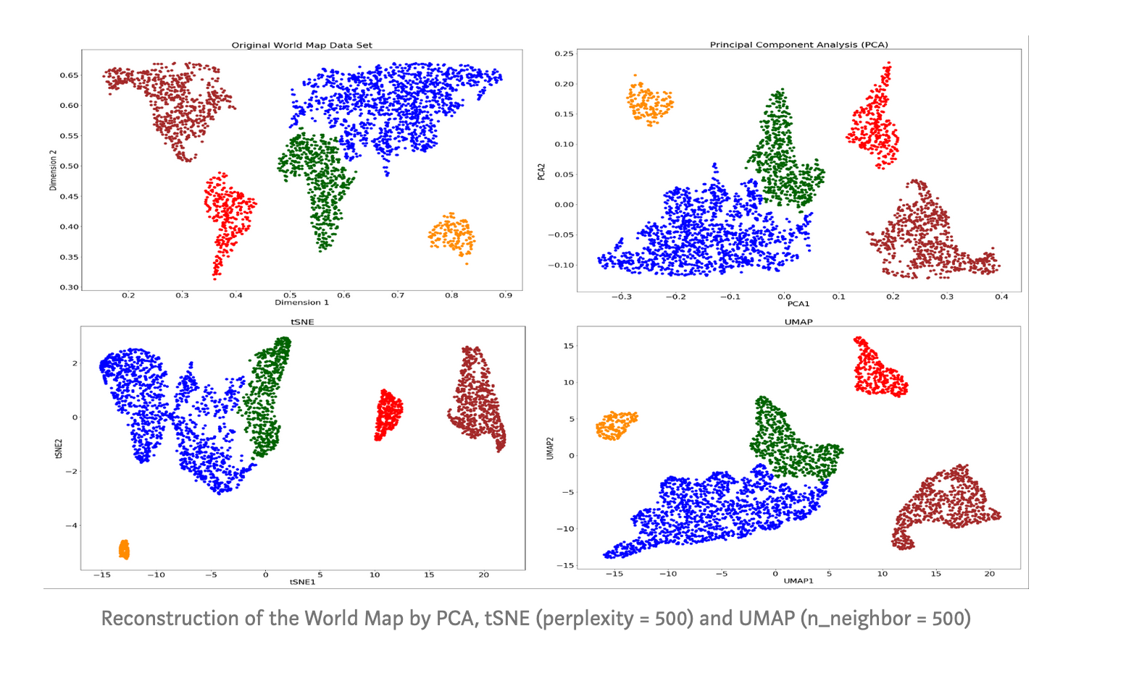
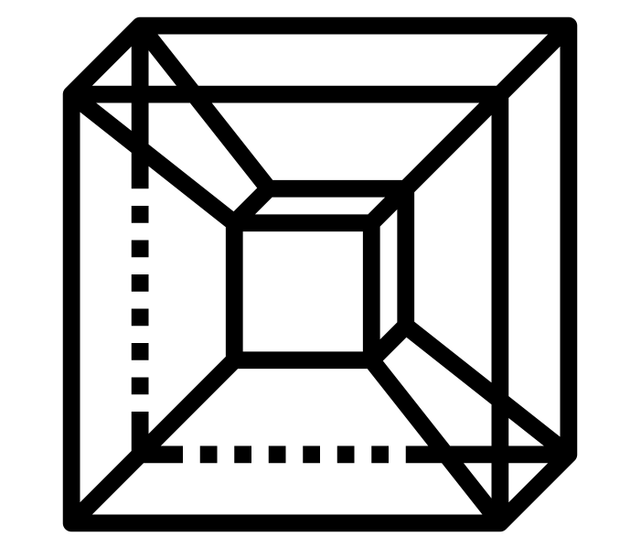
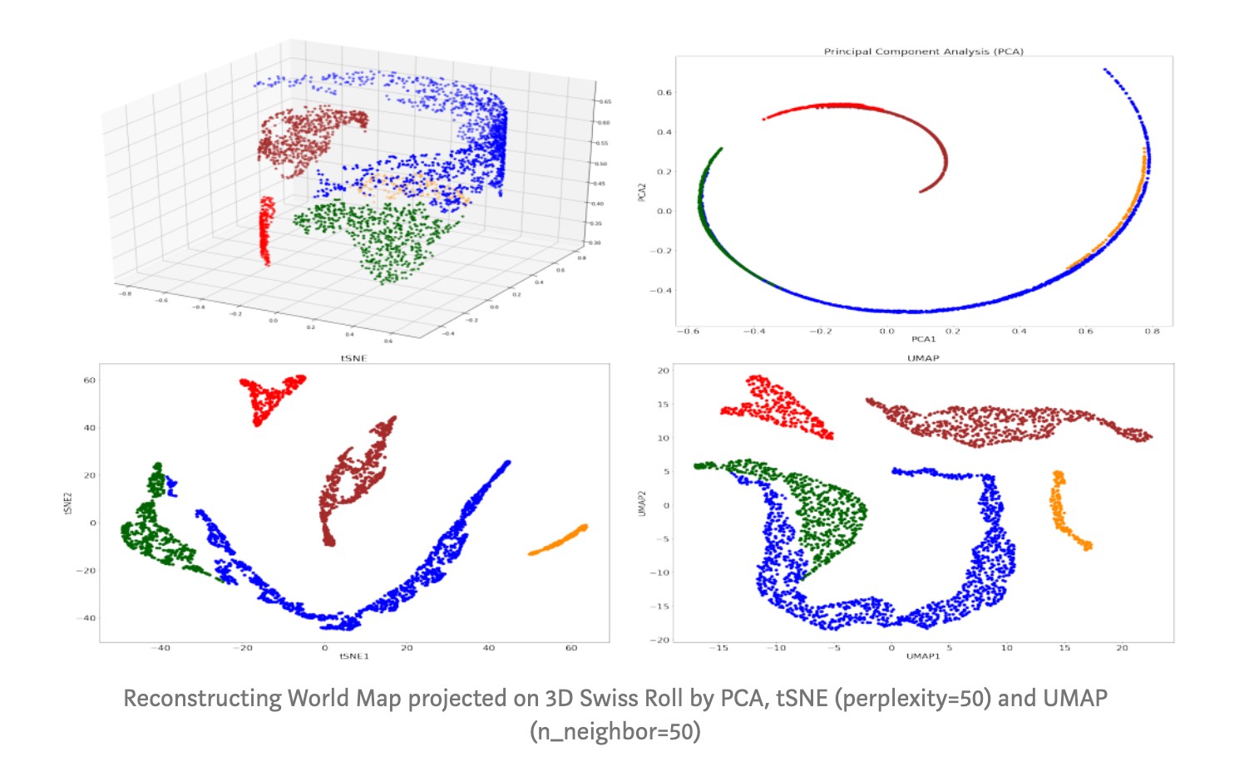
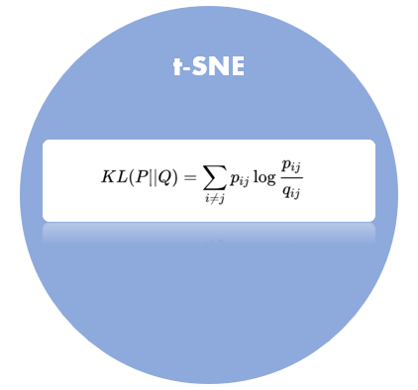
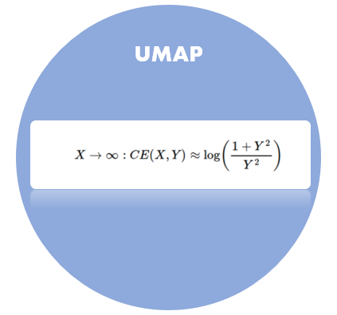
Dimensionality
Reduction

Slide 14
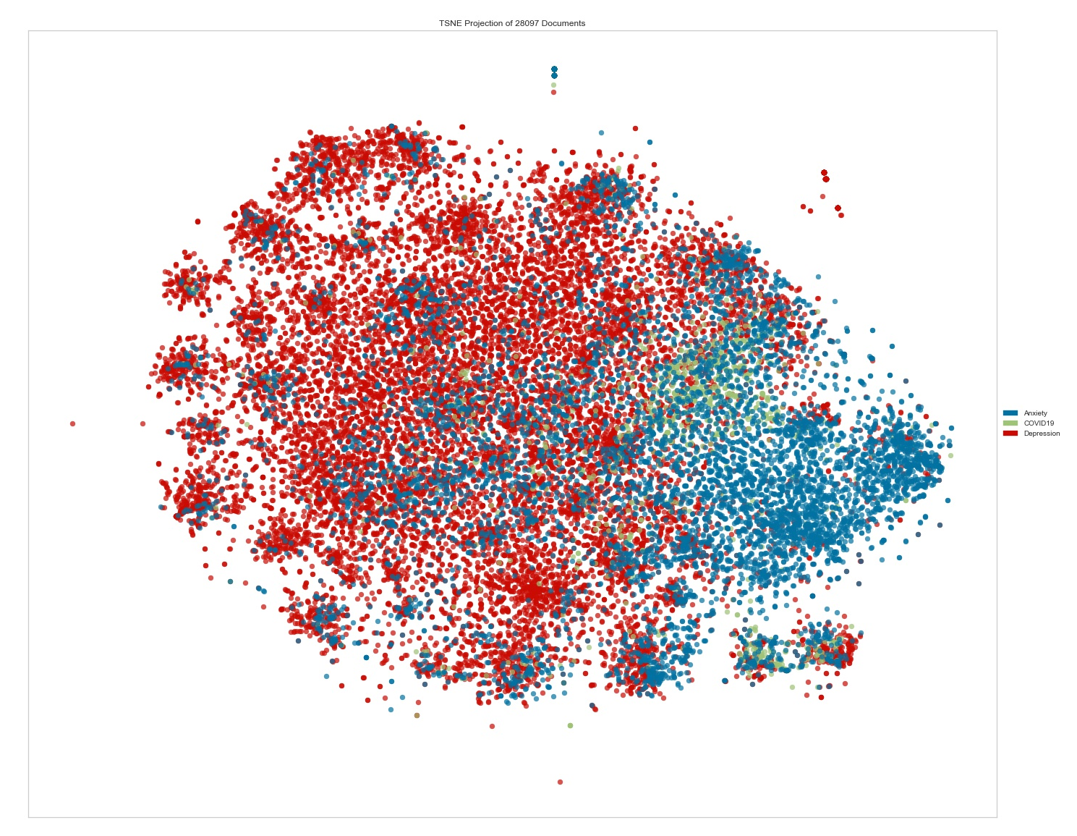
t-SNE

Slide 15
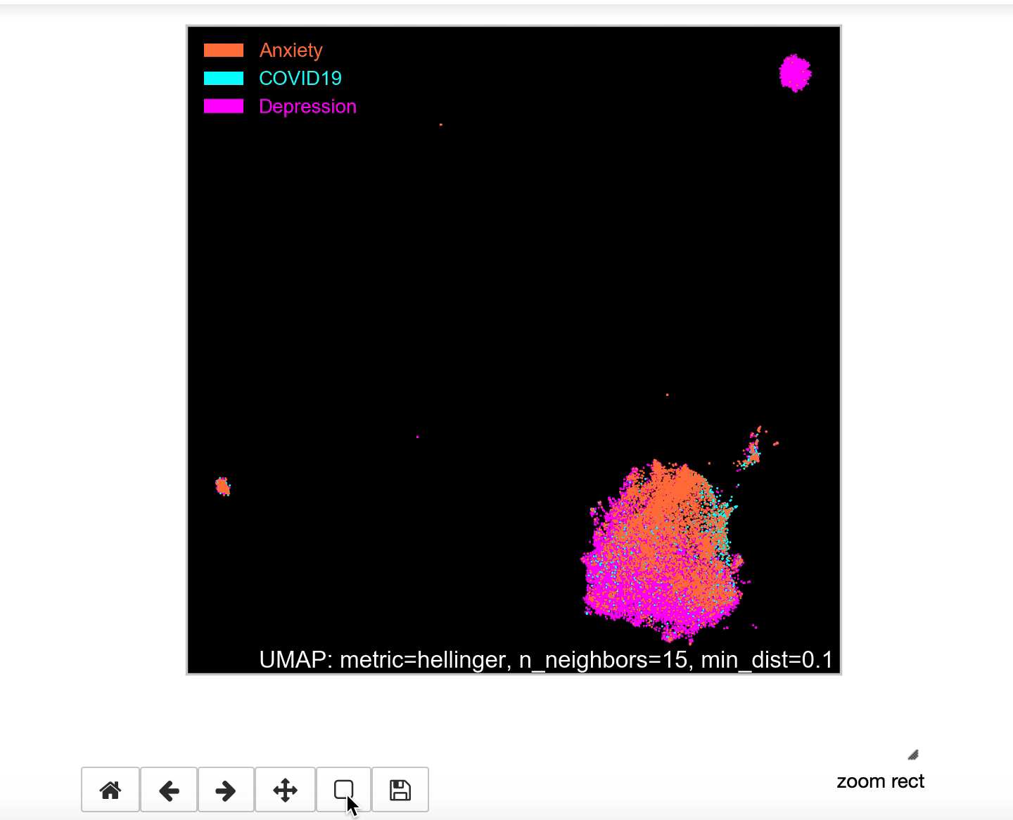
UMAP

Slide 16

Evaluation

Slide 17
Topic Modeling
Comparison
Anxiety
Depression
COVID
LDA | CorEx Topic
feel, like, know, want, think, time, thing, people | tell ,way ,lot ,long ,happen ,point ,mind ,thought problem ,away
feel, like, attack, panic, day, start, time, bad; | job ,life ,need ,find ,end ,month ,mental ,therapy health ,depression
work, job, home, know, day, week, live, virus | friend ,talk ,good ,school ,person ,relationship ,ask ,look ,love ,social
mg, medication, doctor, help, med, prescribe, effect, try | home ,live ,family , virus ,leave ,parent ,house ,stay ,old , die
movie, water, ok, bat, use, watch, dentist, age | heart ,chest ,symptom ,attack ,pain ,panic ,night ,sleep ,wake ,doctor
sex, cough, fever, throat, temperature, pregnant, earthquake, condom | mg ,prescribe, medication ,effect ,dose ,med ,psychiatrist ,zoloft ,lexapro ,xanax
LDA | CorEx Topic
feel, like, want, know, life, think, thing, time | mental ,self ,anxiety ,health ,issue ,hard ,kind ,change ,struggle ,experience
talk, tell, help, friend, know, ask, people, need | find ,love ,relationship , person ,long ,look ,point ,ask ,problem ,girl
school, year, friend, parent, time, start, college, mom | job ,live ,family ,home ,parent ,old ,leave ,month ,mom ,money
day, sleep, week, eat, night, bed, hour, room | school ,college ,high ,class ,grade ,new ,study ,student ,graduate ,social
mental, health, medication, anxiety, help, therapy, med, doctor | sleep ,bed , play ,eat ,night ,room ,sit ,spend ,watch , game
job, work, money, pay, live, home, house, month | care ,end ,away ,happy ,cry ,anymore ,shit ,feeling ,die ,hate
LDA | CorEx Topic
know, feel, like, work, people, home, want, live | family ,life ,friend , month ,social, situation ,self, mean ,love ,worry
people, day, work, feel, know, like, time, think | year ,old ,risk ,dad ,worried, sick ,parent mother ,die ,fear
work, virus, time, know, day, people, like, help | away ,today ,tell ,hour ,leave ,care ,house ,wake ,night ,understand
people, feel, like, year, time, know, life, thing | health ,information ,news ,find ,share ,org ,covid ,mental ,coronavirus ,support
like, feel, people, anxiety, day, symptom, think, know | wipe, food ,use ,store ,clean ,grocery, place ,door ,wear ,mask
people, feel, virus, know, school, day, year, anxiety | cough ,fever ,throat ,chest ,symptom ,hand ,nose ,test ,wash ,breath
Conclusion: Topics produced by Corex Topic were less repetitive and more coherent. The additional functionality to nudge topics that are “undercooked” or “overcooked” also improved the results.

Slide 18
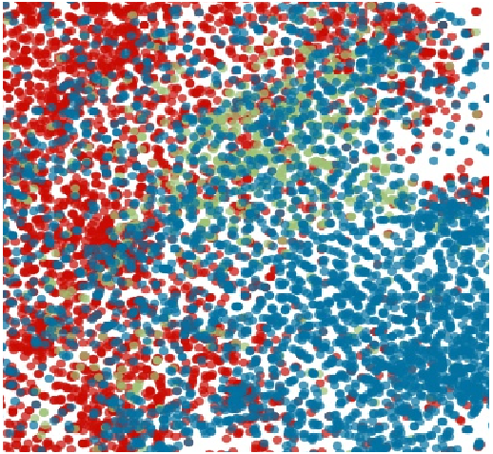
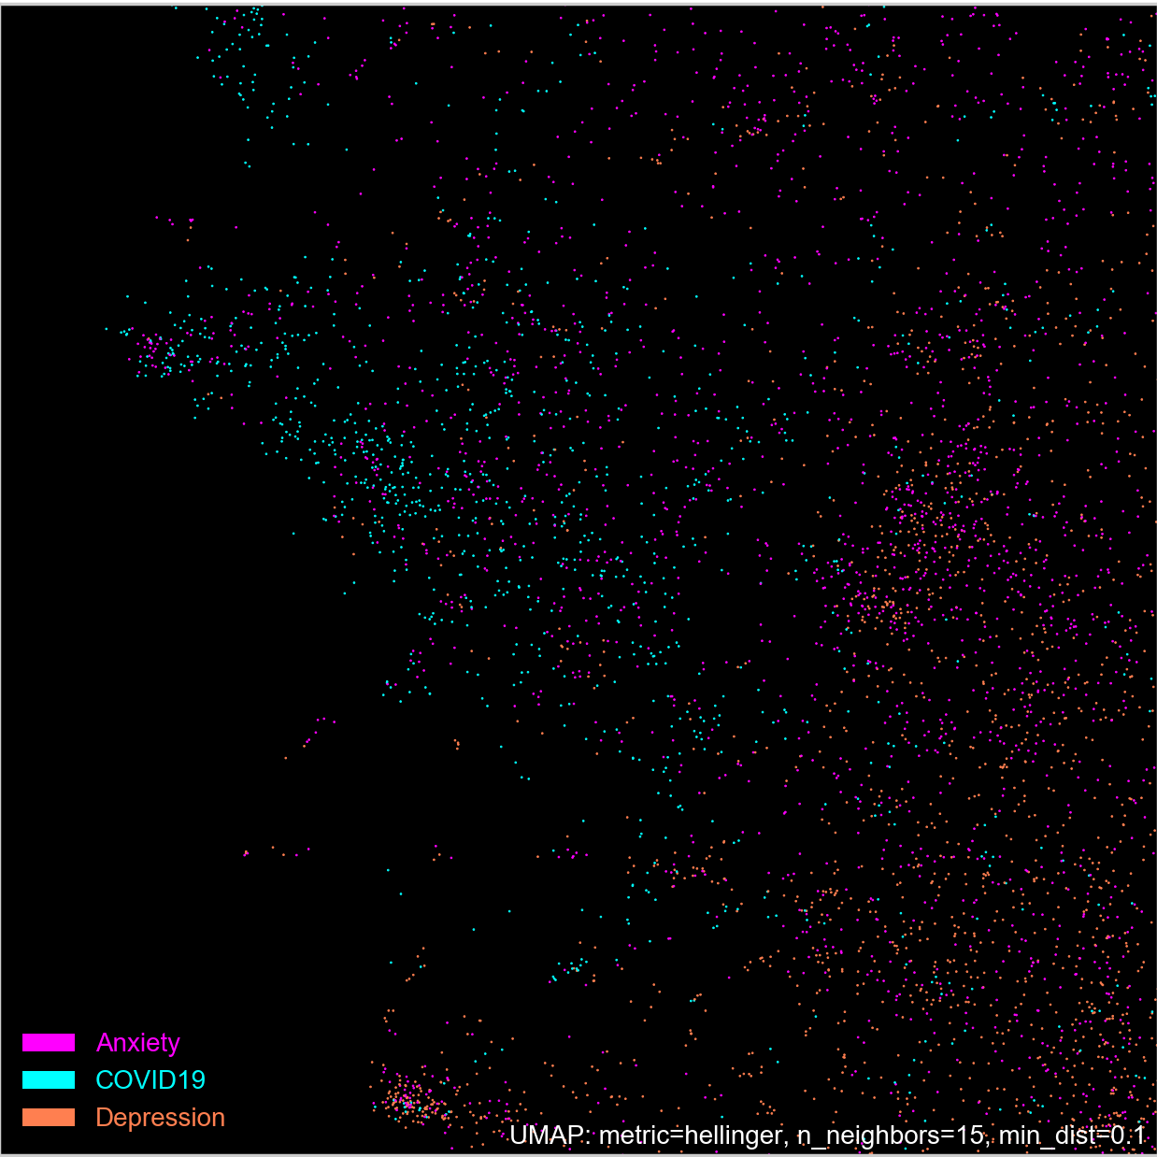
Dimensionality Reduction Comparison
t-SNE
UMAP
Conclusion: Umap and t-SNE are similar, but umap appears to perform better at showing the distances between points and preserving the global structure of the data.

Slide 19
https://public.tableau.com/views/FinalHorsemenTableauTinkering/AnxietyWords?:display_count=y&publish=yes&:origin=viz_share_link

